Slide 1



Helping the World SEE!

Slide 2
EXPLORATION: What We Learned
Since November of 2021, Springboard International has been engaged with ABO-NCLE, OAA, and NFOS to explore the opportunity of merging organizations to form a single flagship association.
“Where there is unity, there is always victory.” – Publilius Syrus

Slide 3
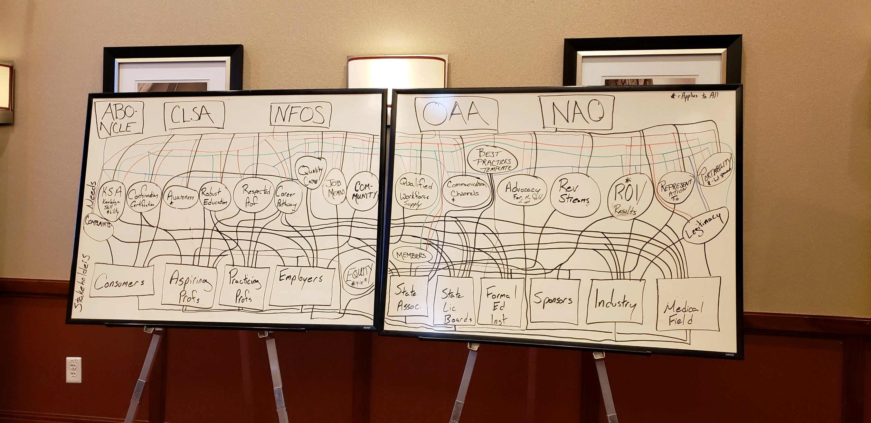
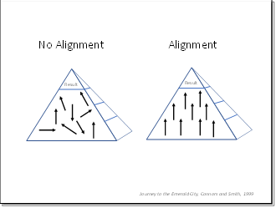
EXPLORATION: What We Learned
Duplication of Efforts
“Where there is unity, there is always victory.” – Publilius Syrus

Slide 4

PLANNING: Single Vision, Multifocal Mission
Vision: Helping the World SEE!
Mission: To support, promote and advance the profession of Opticianry and other Ophthalmic professions through education, credentialing, and advocacy to serve the vision care needs of the public.

Slide 5
PLANNING: Shared Values
Integrity Demonstrating integrity through ethical, transparent, and well-intentioned decisions for the Ophthalmic Community and the Patients it serves
Knowledge Assuring knowledge of Ophthalmic Professionals through evidence-based competency, education, and mentorship
Advocacy Championing competent eye care professionals
Unity
Assuring a diverse community of Ophthalmic Professionals collaborating for a common synergistic goal
Communication Give open, honest and respectful communication to the Optical industry at large

Slide 6
PLANNING: Shared Goals
Establish, Support, and Strengthen Partner Associations
2
Concerted Advocacy to End Deregulation, Promote Licensure, and Protect the Profession
3
Increasing Availability and Access to Evidence-Based Education and Training
4
Strengthen the Field of Opticianry and Contact Lens Dispensing
5
Global Awareness of Opticianry and its Value to Patient Care
1
“Open your arms to change, but don’t let go of your values.” Dalai Lama

Slide 7
PLANNING: Shared Goals
Long-term Sustainability
Fully Staffed Program Efforts (as opposed to fully volunteer-led initiatives)
Increase Visibility of Field to Consumers and Industry
Increase Revenue Through Membership and Awareness/Marketing
Expand Membership Beyond What Individual Organizations Can Do on Their Own

Slide 8
PLANNING: Strategies to Achieve Goals
Rigorous Credentialing
Quality Professional Education
Empowered Community of Thriving Professionals
Valued Profession and Partner
Public Policy Information and Advocacy
Vision Philanthropy and Public Service
“If everyone is moving forward together, then success takes care of itself.” – Henry Ford

Slide 9
PLANNING: Organizational Services
Programs
Government Affairs
Operations/Support
Marketing, Communication & Events
“Alone we can do so little; together we can do so much.” – Helen Keller

Slide 10
PLANNING: Organizational Structure

Slide 11
Implementation & Integration: Next Steps
Board of Directors
Leadership/Management Team
Staffing
Human Resources Function
Organizational Culture
Programs
Financial Systems and Processes
IT Systems and Processes
Facilities and Equipment
Fundraising and Sponsorships
Non-Profit Foundations
Accreditation
Communication (internal and external)
Merger Costs

Slide 12
Implementation & Integration: Timeline

Slide 13
STRONGER TOGETHER!

